Slide 1
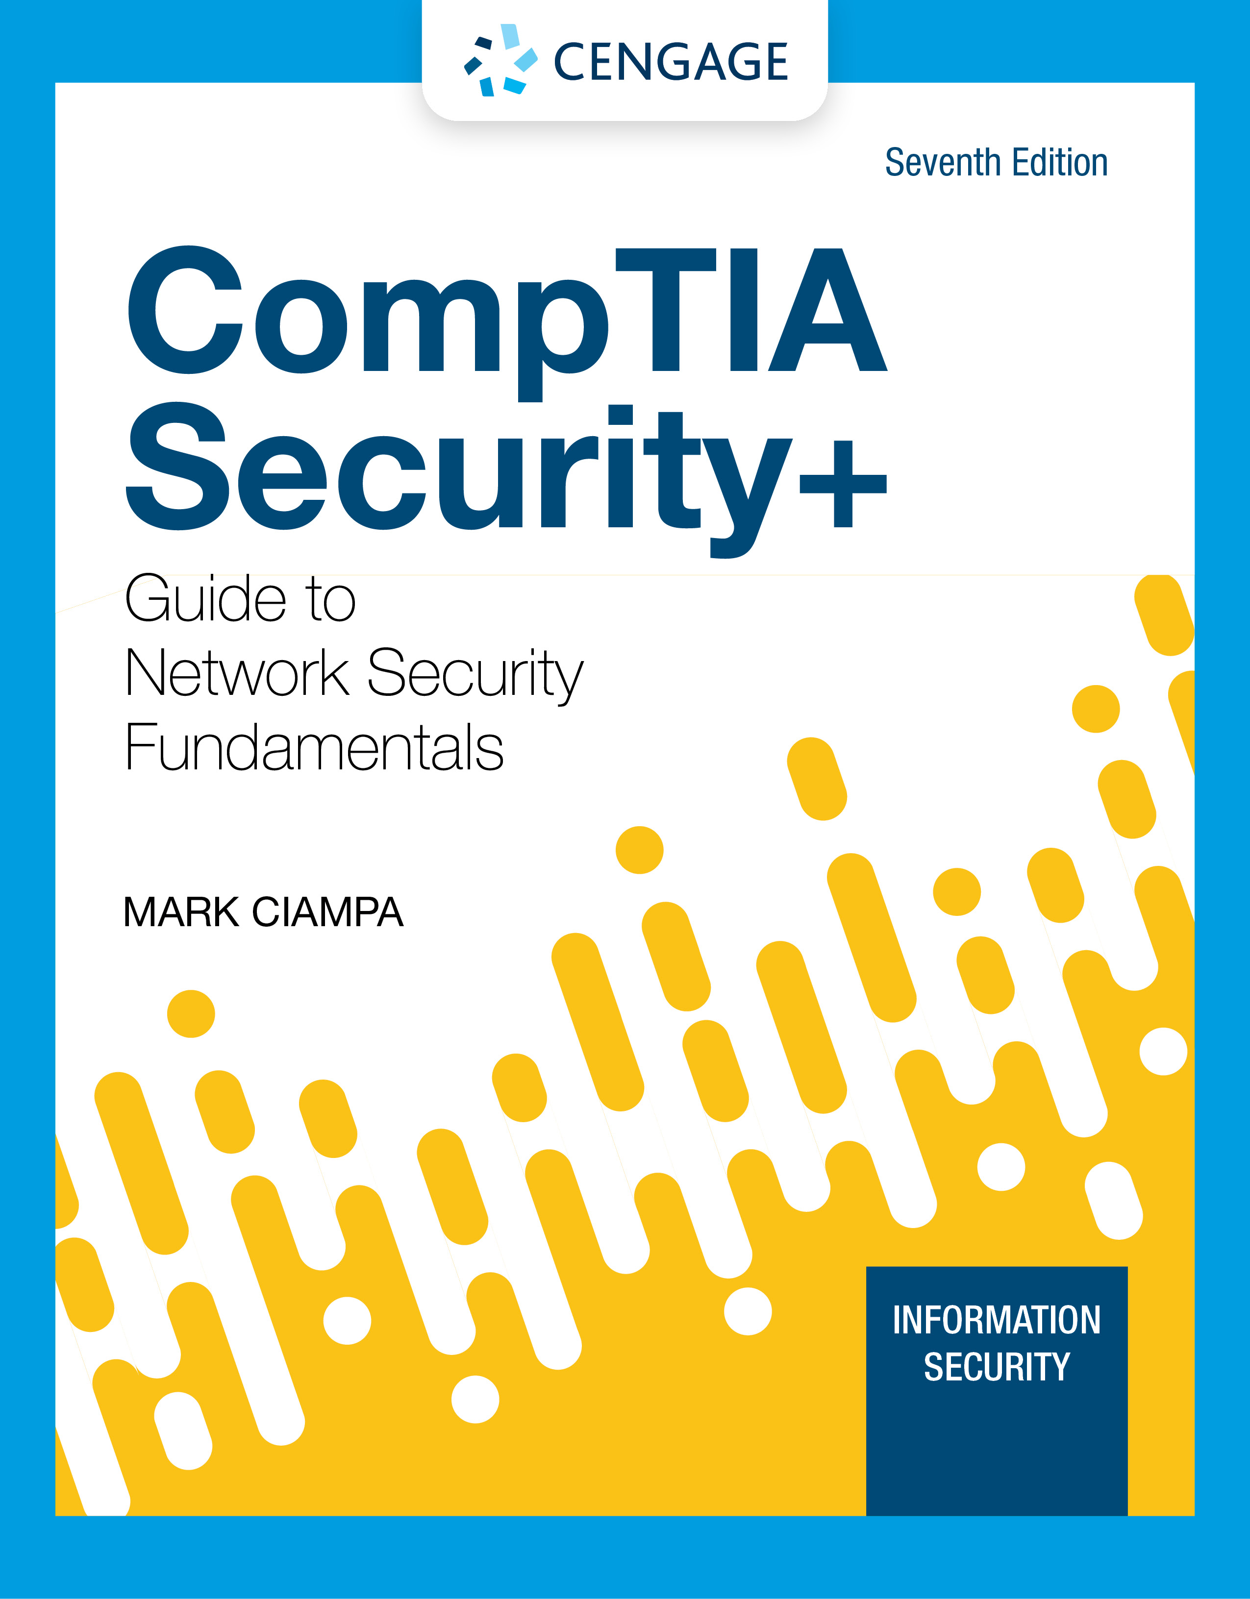
Module 2: Threat Management and Cybersecurity Resources
CompTIA Security+ Guide
to Network Security Fundamentals, 7th Edition

Slide 2
Module Objectives
By the end of this module, you should be able to:
1. Explain what a penetration test is
2. Identify the rules of engagement and how to perform a pen test
3. Define vulnerability scanning
4. Describe different cybersecurity resources

Slide 3
Penetration Testing
Studying penetration testing involves:
Defining what it is and why such a test should be conducted
Examining who should perform the tests and the rules for engagement
Knowing how to perform a penetration test

Slide 4
Defining Penetration Testing
Penetration testing attempts to exploit vulnerabilities in order to help:
Uncover new vulnerabilities
Provide a clearer picture of their nature
Determine how they could be used against the organization
The most important element in a “pen test” is the first step: planning
A lack of planning can result in creep, which is an expansion beyond the initial set of the test’s limitations
The most dangerous result of poor planning is creating unnecessary legal issues

Slide 5
Why Conduct a Test?
A scan of network defenses usually finds only surface problems to be addressed
Many network scans are automated and provide only limited verification of vulnerabilities
A penetration test can find deep vulnerabilities and attempts to exploit vulnerabilities using manual techniques
The attacks:
Must be the same as those used by a threat actor
Should follow the thinking of threat actors

Slide 6
Who Should Perform the Test? (1 of 3)
Internal Security Personnel
Advantages to using internal employees include:
There is little or no additional cost
The test can be conducted much more quickly
An in-house pen test can be used to enhance the training of employees and raise the awareness of security risks
Disadvantages of using internal security employees:
Inside knowledge
Lack of expertise
Reluctance to reveal

Slide 7
Who Should Perform the Test? (2 of 3)
External Pen Tester Consultants
Contracting with an external pen testing consultant offers the following advantages:
Expertise
Credentials
Experience
Focus
A disadvantage of using external consultants is the usage of the information uncovered
A contractor who conducts a pen test learns all about an organization’s network and may receive extremely sensitive information about systems and how to access them
This knowledge could be sold to a competitor

Slide 8
Who Should Perform the Test? (3 of 3)
Crowdsourced Pen Testers
A bug bounty is a monetary reward given for uncovering a software vulnerability
Bug bounty programs take advantage of crowdsourcing, which involves obtaining input into a project by enlisting the services of many people through the internet
Advantages of crowdsourced pen testers include the following:
Faster testing, resulting in quicker remediation of vulnerabilities
Ability to rotate teams so different individuals test the system
Option of conducting multiple pen tests simultaneously

Slide 9
Knowledge Check Activity 1
What is the first step in penetration testing and what is its importance?
a. Planning, because a lack of planning can result in legal issues.
b. Targeting, because the pen tester must know which systems to attempt to penetrate.
c. Targeting; the targets will determine which tools are needed for the pen test.
d. Planning, but this step can often be skipped if the tester is in a hurry.

Slide 10
Knowledge Check Activity 1: Answer
What is the first step in penetration testing and what is its importance?
Answer: a. Planning, because a lack of planning can result in legal issues.
Planning is the first step and is not an optional step. A lack of planning can result not only in a poorly defined penetration test but also in legal issues.

Slide 11
Rules of Engagement (1 of 5)
Rules of engagement in a penetration test are its limitations or parameters
Categories for rules of engagement are:
Timing
Scope
Authorization
Exploitation
Communication
Cleanup
Reporting

Slide 12
Rules of Engagement (2 of 5)
Timing
The timing parameter sets when the testing will occur
Some considerations include: the start and stop dates of the test and should the active portions of the pen test be conducted during normal business hours
Scope
Scope involves several elements that define the relevant test boundaries:
Environment
Internal targets
External targets
Target locations
Other boundaries

Slide 13
Rules of Engagement (3 of 5)
Authorization
Authorization is the receipt of prior written approval to conduct the pen test
A formal written document must be signed by all parties before a pen test begins
Exploitation
The exploitation level in a pen test should be part of the scope that is discussed in the planning stages
Communication
The pen tester should communicate with the organization during the following occasions:
Initiation
Incident response
Status
Emergency

Slide 14
Rules of Engagement (4 of 5)
Cleanup
The pen tester must ensure that everything related to the pen test has been removed
Cleanup involves removing all software agents, scripts, executable binaries, temporary files, and backdoors from all affected systems
Any credentials that were changed should be restored and any usernames created should be removed
Reporting
Once the pen test is completed, a report should be generated to document its objectives, methods used, and results
The report should be divided into two parts:
An executive summary designed for a less technical audience
A more technical summary written for security professionals

Slide 15
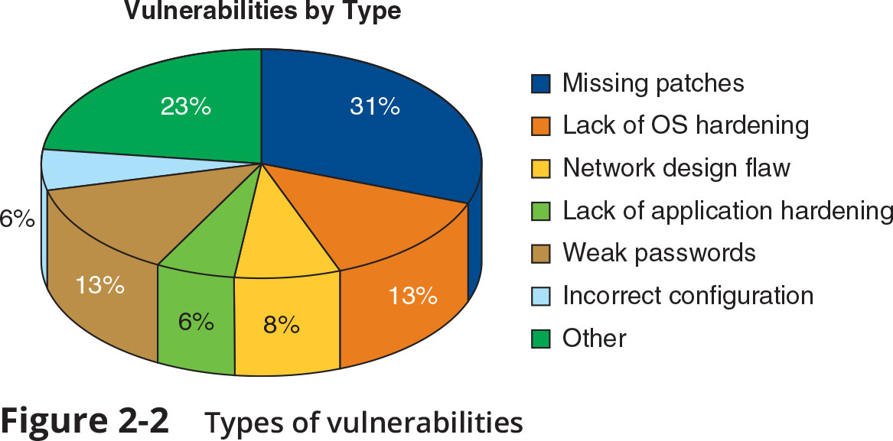
Rules of Engagement (5 of 5)
Figure 2-2 Types of vulnerabilities

Slide 16
Performing a Penetration Test (1 of 4)
Performing a successful pen test involves determination, resolve, and perseverance
A variety of actions take place when performing a pen test, however, they can be grouped into two phases:
Reconnaissance
Penetration

Slide 17
Performing a Penetration Test (2 of 4)
Phase 1: Reconnaissance
The first task is to perform preliminary information gathering from outside the organization (called footprinting)
Information can be gathered using two methods: active reconnaissance and passive reconnaissance
Active reconnaissance involves directly probing for vulnerabilities and useful information
War driving is searching for wireless signals from an automobile or on foot while using a portable device
War flying uses drones, which are officially known as unmanned aerial vehicles (UAVs)
A disadvantage of active reconnaissance is that the probes are likely to alert security professionals that something unusual is occurring

Slide 18
Performing a Penetration Test (3 of 4)
Phase 1: Reconnaissance (continued)
Passive reconnaissance occurs when the tester uses tools that do not raise any alarms
This may include searching online for publicly accessible information called open source intelligence (OSINT) that can reveal valuable insight about the system
Phase 2: Penetration
A pen test is intended to simulate the actions of a threat actor
The initial system compromised usually does not contain the data that is the goal of the attack
That system usually serves as a gateway for entry into an organization network
Once inside the network, threat actors turn to other systems to be compromised until they reach the ultimate target

Slide 19
Performing a Penetration Test (4 of 4)
Phase 2: Penetration (continued)
Lessons to be learned from how threat actors work include:
When a vulnerability is discovered, the pen tester must determine how to pivot (turn) to another system using another vulnerability to continue moving toward the target
Vulnerabilities that are not part of the ultimate target can still provide a gateway to the target
Pen tests are manual, therefore, a pen tester needs to design attacks carefully
Pen testers must be patent and persistent, just like the threat actors

Slide 20
Knowledge Check Activity 2
What are the two primary phases of penetration testing in order?
a. Penetration, escalation
b. Penetration, pivoting
c. Reconnaissance, footprinting
d. Reconnaissance, penetration

Slide 21
Knowledge Check Activity 2: Answer
What are the two primary phases of penetration testing in order?
Answer: d. Reconnaissance, penetration
Reconnaissance is a necessary first phase because proper reconnaissance gathers the information needed to perform a proper penetration test. Reconnaissance is followed by the second phase; the actual attempt at penetration.

Slide 22
Vulnerability Scanning
Vulnerability scanning in some ways complements pen testing
Studying vulnerability scanning involves understanding:
What it is
How to conduct a scan
How to use data management tools
How threat hunting can enhance scanning

Slide 23
What is a Vulnerability Scan?
A penetration test is a single event using a manual process often performed only after a specific amount of time has passed
A vulnerability scan is a frequent and ongoing process that continuously identifies vulnerabilities and monitors cybersecurity progress

Slide 24
Conducting a Vulnerability Scan (1 of 6)
Conducting a vulnerability scan involves:
Knowing what to scan and how often
Selecting a type of scan
Interpreting vulnerability information
When and What to Scan
Two primary reasons for not conducting around-the-clock vulnerability scans:
Workflow interruptions
Technical constraints
A more focused approach is to know the location of data so that specific systems with high-value data can be scanned more frequently

Slide 25
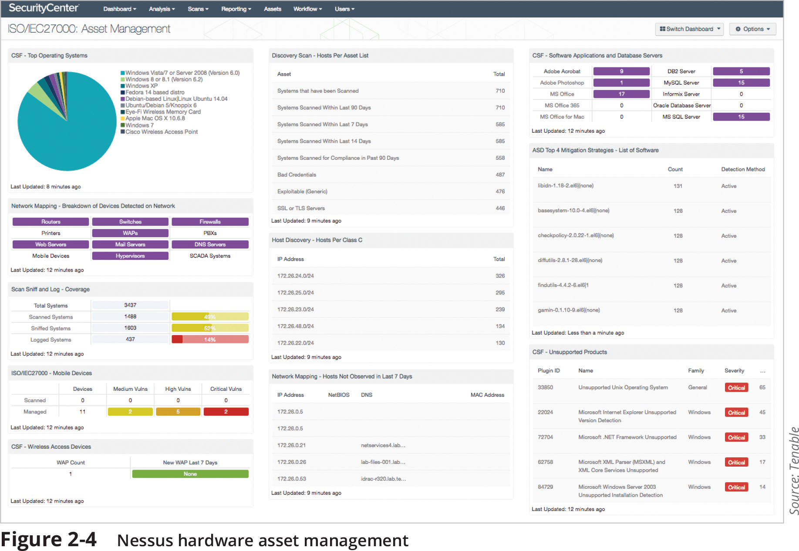
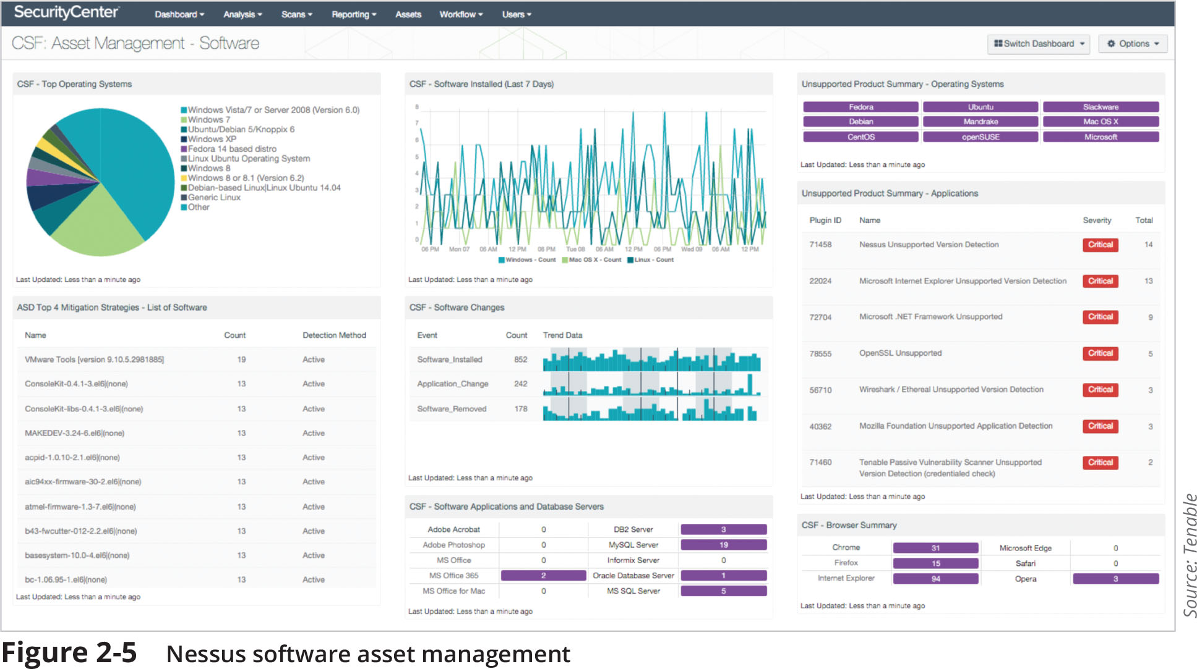
Conducting a Vulnerability Scan (2 of 6)

Slide 26
Conducting a Vulnerability Scan (3 of 6)
Because a vulnerability scan should be limited, a configuration review of software settings should be conducted
Define the group of target devices to be scanned
Ensure that a scan should be designed to meet its intended goals
Determine the sensitivity level or the depth of a scan
Specify the data types to be scanned

Slide 27
Conducting a Vulnerability Scan (4 of 6)
Types of Scans
Two major types of scans are credentialed scans and intrusive scans
In a credentialed scan, valid authentication credentials are supplied to the vulnerability scanner to mimic the work of a threat actor who possesses these credentials
A non-credentialed scan provides no such authentication information
An intrusive scan attempts to employ any vulnerabilities that it finds
A nonintrusive scan does not attempt to exploit the vulnerability but only records that it was discovered
Vulnerability Information
Vulnerability scanning software compares the software it scans against a set of known vulnerabilities
Vulnerability information is available to provide updated information to scanning software about the latest vulnerabilities

Slide 28
Conducting a Vulnerability Scan (5 of 6)
Examining Results
When examining the results of a vulnerability scan, you should assess the importance of vulnerability as well as its accuracy
Questions that may help identify which vulnerability needs early attention:
Can the vulnerability be addressed in a reasonable amount of time?
Can the vulnerability be exploited by an external threat actor?
If the vulnerability led to threat actors infiltrating the system, would they be able to pivot to more important systems?
Is the data on the affected device sensitive or is it public?
Is the vulnerability on a critical system that runs a core business process?
Another part of prioritizing is making sure that the difficulty and time for implementing the correction is reasonable

Slide 29
Conducting a Vulnerability Scan (6 of 6)
Examining Results (continued)
Another consideration when examining results is accuracy
Be sure to identify false positives, which is an alarm raised when there is no problem
A means to identify false positives is to correlate the vulnerability scan data with several internal data points
Most common are related to log files
Log reviews, or an analysis of log data, can be used to identify false positives

Slide 30
Data Management Tools (1 of 3)
Two data management tools are used for collecting and analyzing vulnerability scan data:
Security Information and Event Management (SIEM)
Security Orchestration, Automation, and Response (SOAR)
Security Information and Event Management (SIEM)
A SIEM typically has the following features:
Aggregation
Correlation
Automated alerting and triggers
Time synchronization
Event duplication
Logs

Slide 31
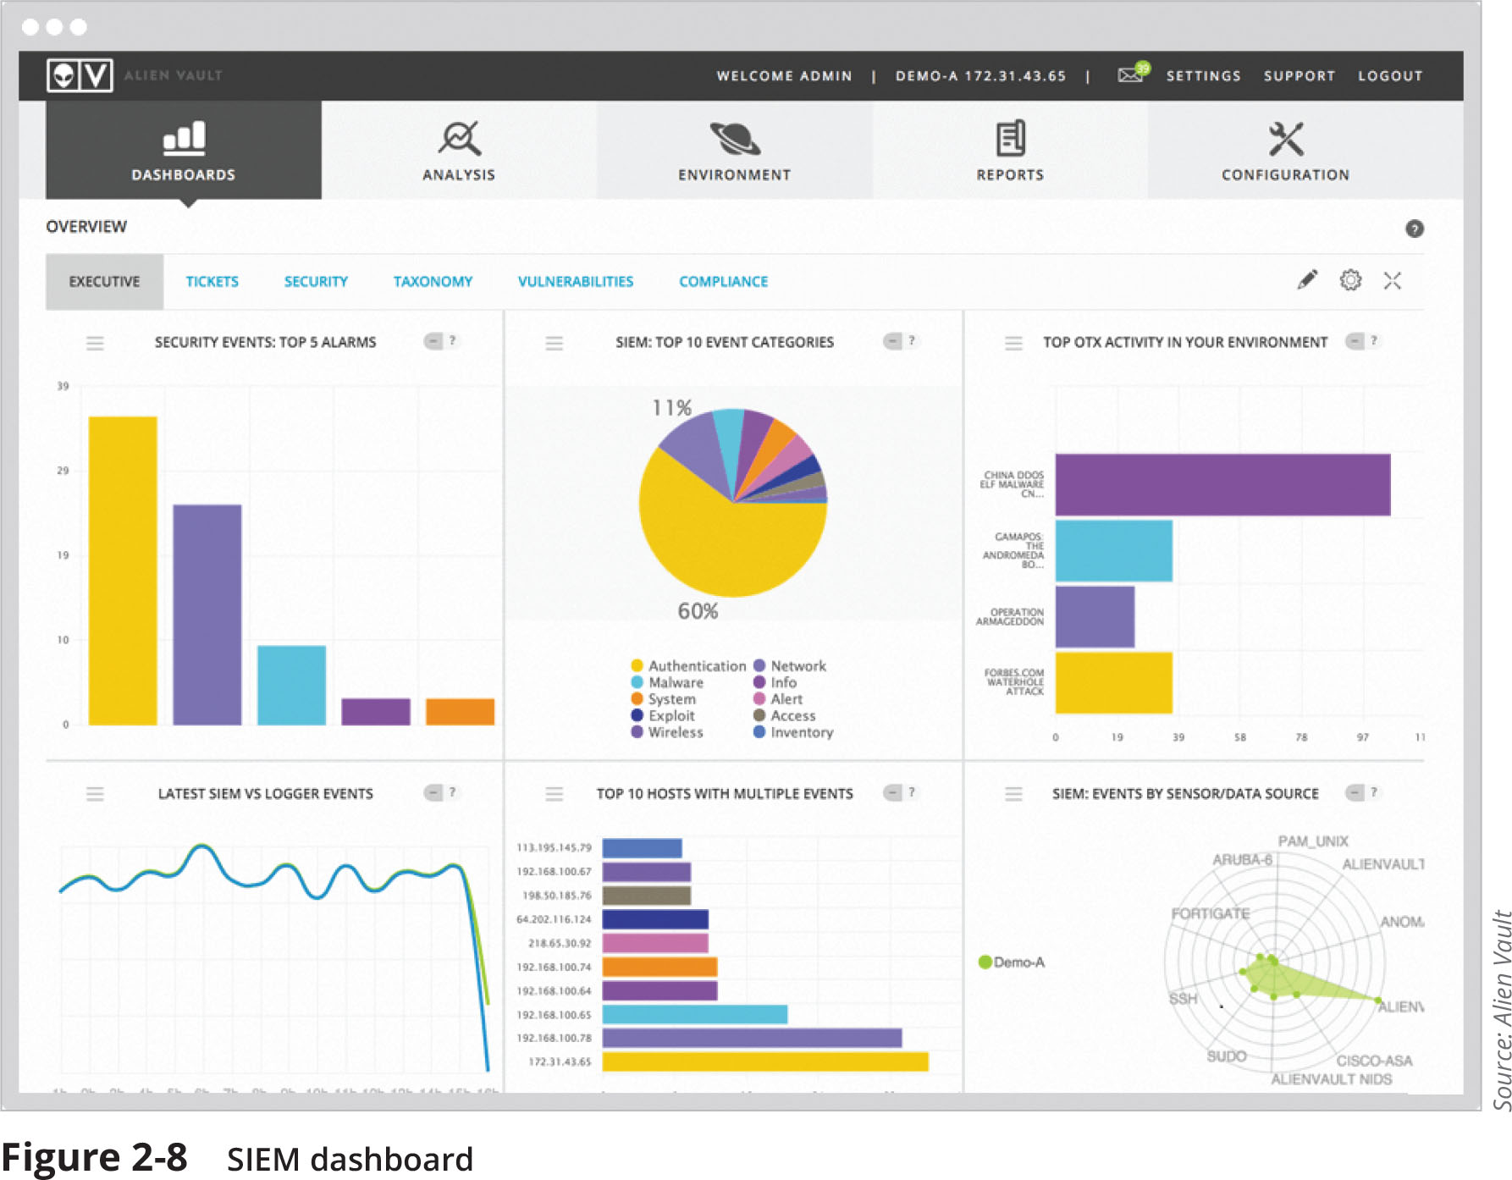
Data Management Tools (2 of 3)
Figure 2-8 SIEM dashboard

Slide 32
Data Management Tools (3 of 3)
SIEMS can also perform sentiment analysis, which is the process of computationally identifying and categorizing opinions to determine the writer’s attitude toward a particular topic
Sentiment analysis has been used when tracking postings threat actors make in discussion forums with other attackers to better determine the behavior and mindset of threat actors
Security Orchestration, Automation, and Response (SOAR)
A SOAR is similar to a SIEM in that it is designed to help security teams manage and respond to security warnings and alarms
SOARs combine more comprehensive data gathering and analytics to automate incident responses

Slide 33
Threat Hunting
Threat hunting is proactively searching for cyber threats that thus far have gone undetected in a network
It begins with a critical premise: threat actors have already infiltrated our network
It proceeds to find unusual behavior that may indicate malicious activity
Threat hunting investigations often use crowdsourced attack data such as:
Advisories and bulletins
Cybersecurity threat feeds – data feeds of information on the latest threats
Information from a fusion center – a formal repository of information from enterprises and the government used to share information on the latest attacks

Slide 34
Knowledge Check Activity 3
Which of the following is NOT typically a feature of a SIEM?
a. Aggregation
b. Remediation
c. Correlation
d. Event duplication

Slide 35
Knowledge Check Activity 3: Answer
Which of the following is NOT typically a feature of a SIEM?
Answer: b. Remediation
The typical features found in a SIEM are aggregation, correlation, automated triggers and alerts, time synchronization, event duplication, and logs. A SIEM provides analysis and reporting but does not commonly provide remediation of security events.

Slide 36
Cybersecurity Resources
External cybersecurity resources are available to organizations:
Frameworks
Regulations
Legislation
Standards
Benchmarks/secure configuration guides
Information sources

Slide 37
Frameworks (1 of 3)
A cybersecurity framework is a series of documented processes used to define policies and procedures for implementing and managing security controls in an enterprise environment
The most common frameworks are from the:
National Institute of Standards and Technology (NIST)
International Organization for Standardization (ISO)
American Institute of Certified Public Accountants (AICPA)
Center for Internet Security (CIS)
Cloud Security Alliance (CSA)

Slide 38
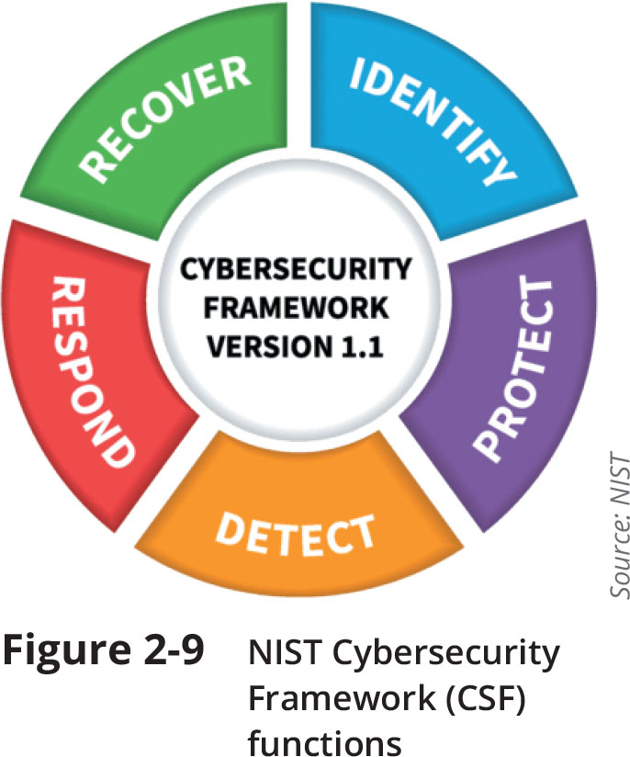
Frameworks (3 of 3)
Figure 2-9 NIST Cybersecurity Framework (CSF) functions

Slide 39
Regulations
The process of adhering to regulations is called regulatory compliance
Industry regulations are typically developed by established professional organizations or government agencies using the expertise of seasoned security professionals
Sample of cybersecurity regulations categories:
Broadly applicable regulations
Industry-specific regulations
U.S. state regulations
International regulations

Slide 40
Legislation
Specific legislation can also be enacted by governing bodies
These include national, territorial, and state laws
Due to a lack of comprehensive federal regulations for data breach notification, many states have amended their breach notification laws from the basic definitions
No two state laws are the same

Slide 41
Standards
A standard is a document approved through consensus by a recognized standardization body
It provides for framework, rules, guidance, or characteristics for products or related processes and production methods
One cybersecurity standard is the Payment Card Industry Data Security Standard (PCI DSS)

Slide 42
Benchmarks/Secure Configuration Guides
Benchmark/secure configuration guides are usually distributed by hardware manufacturers and software developers
They serve as guidelines for configuring a device or software so that it is resilient to attacks
Usually, they are usually platform/vendor-specific guides that only apply to specific products
Guides are available for:
Network infrastructure devices
OSs
Web servers
Application servers

Slide 43
Information Sources
There are a variety of information sources including:
Vendor websites
Conferences
Academic journals
Local industry groups
Social media
A specialized research source is a Request for comments (RFC)
Which are white papers documents that are authored by technology bodies employing specialists, engineers, and scientists who are experts in their field

Slide 44
Discussion Activity
Many schools, especially high schools, restrict IT students from accessing the tools used to perform penetration testing and vulnerability scanning for fear that students will use them for nefarious purposes. Is this a valid concern? Why or why not? Is there a way students can learn about these tools in a manner that is safe and that will ease school administrators’ concerns?
Each student should provide a response to the question.
If this is an online class, responses can be posted in the discussion board and each student should respond with a minimum of 100 words. To encourage interaction, each student should post a minimum 25-word response to another student’s post.
Notes:
Task: This is a discussion activity.
Objectives: To provide a discussion about the possible misuse of penetration and vulnerability scanning tools and what schools should do about it.
Instructions: The instructor should pose the question in #1 to the class. Students should then provide a response to the question. Back-and-forth discussion is encouraged.
Average Time In Class: 30 min
Note: To adapt this activity for an online learning environment, pose the discussion question in the discussion board in your LMS.

Slide 45
Self-Assessment
Complete Case Project 2-2 and Case Project 2-3 from the book. Based on your research, consider the following question and use the knowledge you gained from this module to formulate an answer: If a company has sufficient budget for either a good Pen Test product or a good Vulnerability Scanner, which should they choose and why?

Slide 46
Summary (1 of 2)
Penetration testing attempts to exploit vulnerabilities just as a threat actor would
Using internal employees to conduct a penetration test has advantages in some cases
The rules of engagement in a penetration test are its limitations or parameters
The first phase of a penetration test is reconnaissance, also called footprinting
A penetration test is a single event using a manual process that is usually performed only after a specific amount of time has passed
The best approach for vulnerability scanning is not to scan all systems all the time
Vulnerability information is available to provided updated information to scanning software about the latest vulnerabilities

Slide 47
Summary (2 of 2)
Two data management tools are used for collecting and analyzing data: the Security Information and Event Management (SIEM) tool and a Security Orchestration, Automation, and Response (SOAR) tool
A cybersecurity framework is a series of documented processes used to define policies and procedures for implementation and management of security controls in an enterprise environment
Regulations are another cybersecurity resource
A standard is a document approved through consensus by a recognized standardization body
Deep vulnerabilities can only be exposed through actual attacks that use the mindset of a threat actor

